Slide 1
Introduction to Data Science
Section 08

Slide 2
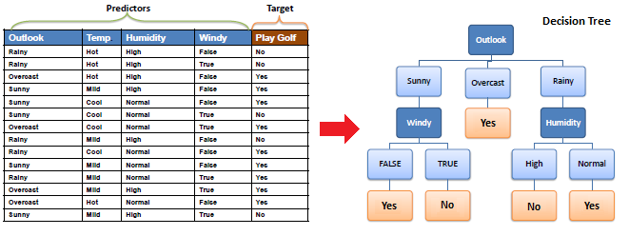
Decision Tree
https://www.saedsayad.com/decision_tree.htm

Slide 3
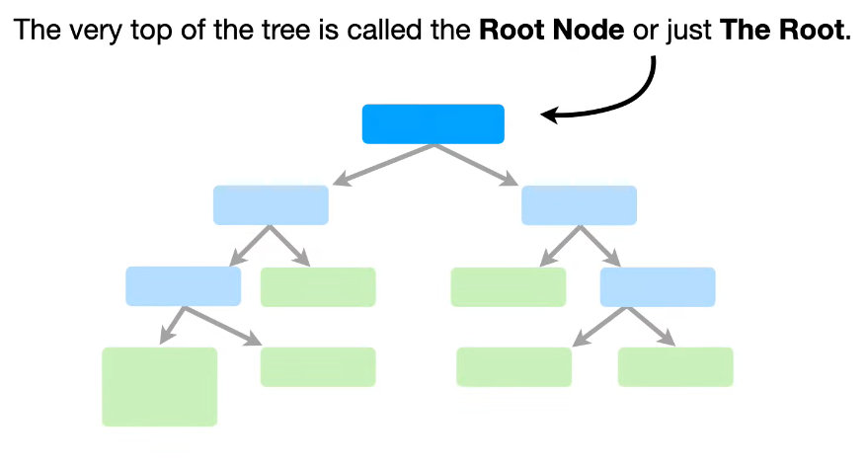
Root Node

Slide 4
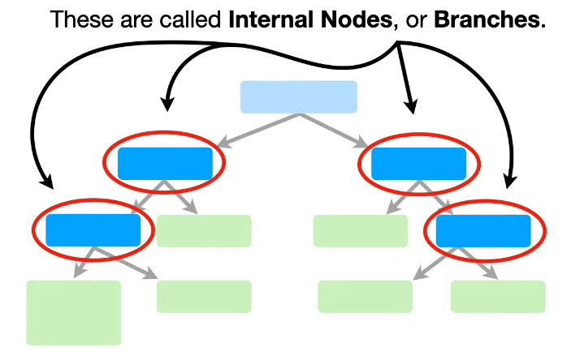
Decision Node/ Internal Node

Slide 5
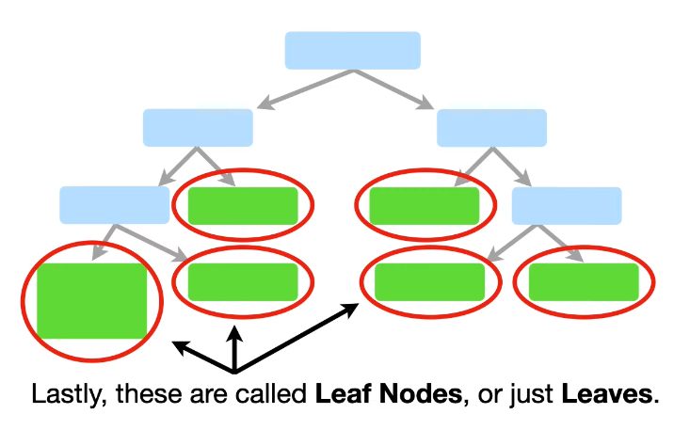
Leaf/ Terminal Node

Slide 6
Decision Tree
A decision tree is a flowchart-like structure in which:
internal node represents a decision on an attribute
branch represents the outcome of that decision
leaf node represents a class label (for classification) or a continuous value (for regression).

Slide 7
How to build a decision tree? Youtube
Decision and Classification Trees, Clearly Explained!!!
StatQuest with Josh Starmer
https://www.youtube.com/watch?v=_L39rN6gz7Y
Has a cool intro song, play the first 10 seconds for fun

Slide 8
Random Forest
Random Forest is an ensemble machine learning algorithm that builds upon the concept of decision trees.
It creates multiple decision trees during training and merges their outputs
Benefit: more accurate and stable predictions.

Slide 9
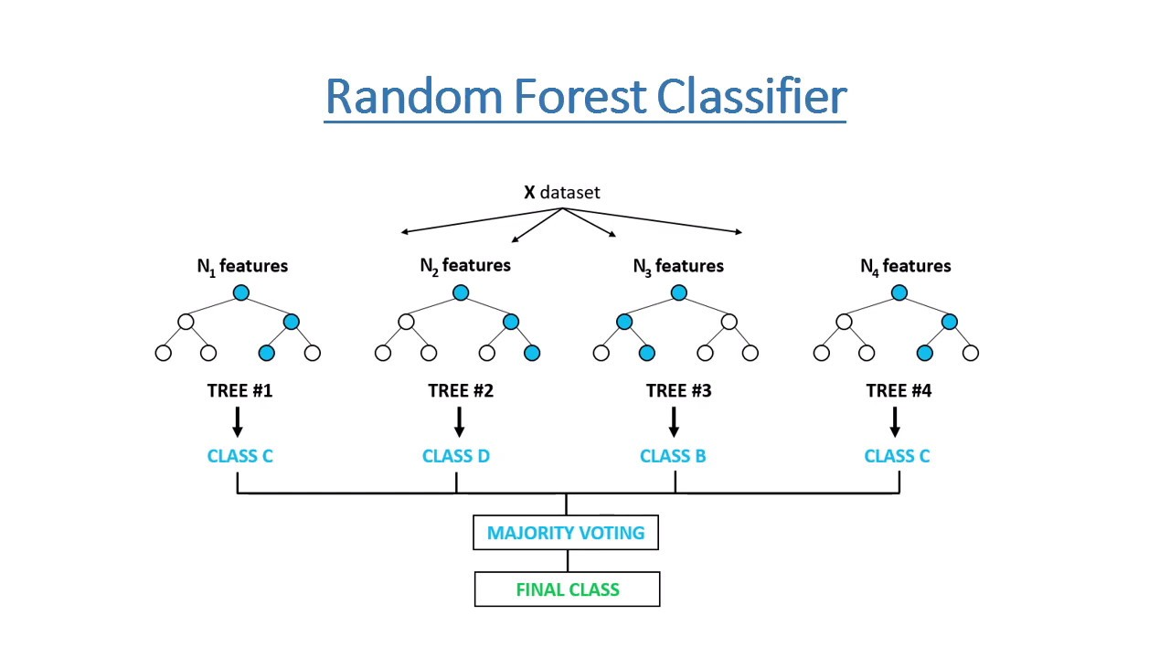
https://tinyurl.com/372jj8jc

Slide 10

Cross Validation https://scikit-learn.org/stable/modules/cross_validation.html

Slide 11
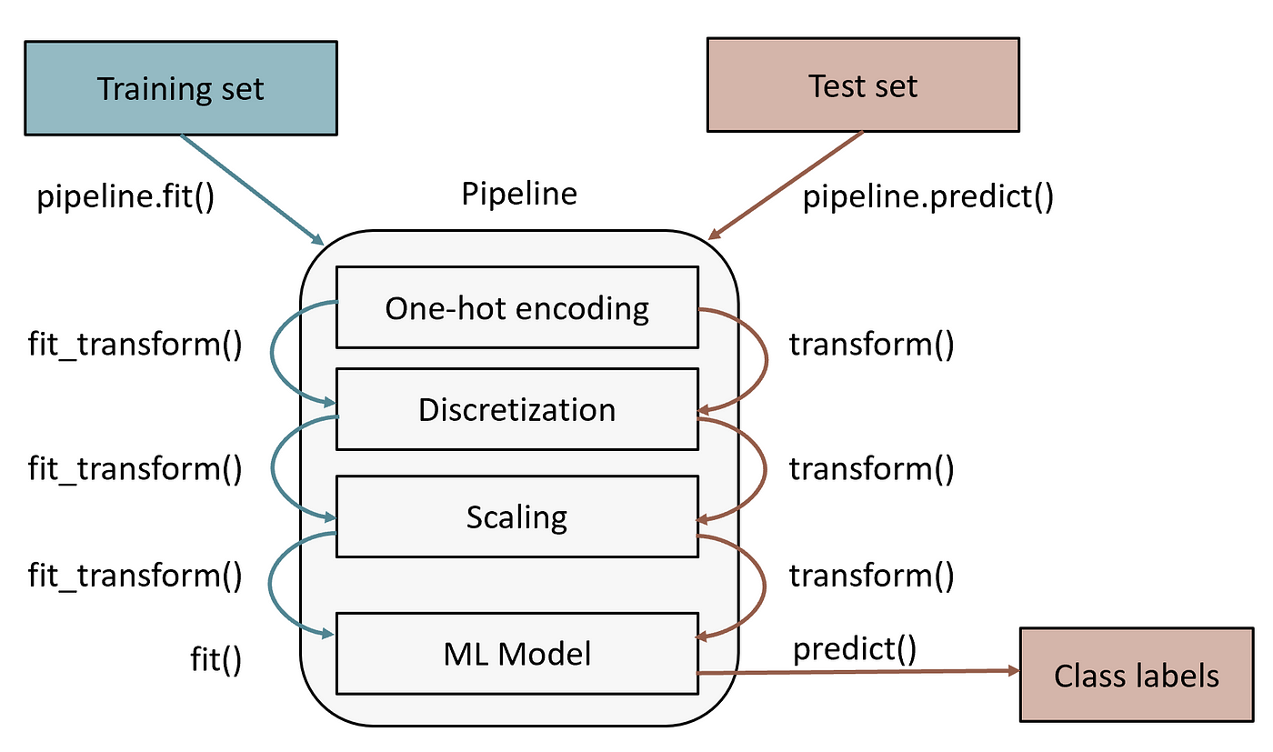
Pipeline basically does the hard work for you

